Slide 1
Understanding public health compliance in emergencies
An investigation of the heterogeneity and pathways of factors that shape our behaviour during public health crises in LMICs Jonas Weinert

Slide 2
Introduction

Slide 3
Relevance: Global & Policy Relevance
Pandemic Impact in LMICs
COVID-19 exposed complex challenges in public health compliance, especially in low- and middle-income countries.
LMICs face unique socio-economic and institutional hurdles not fully captured by HIC-focused research.
A better understanding of behavioural drivers is critical to design effective, context-specific public health interventions.

Slide 4
Relevance: Enabling better policy making
Predicting policy sucess instead of only ex-post evaluations
Policymakers require robust, causal evidence to balance health protection with economic stability.
Identifying the causal pathways in compliance
helps avoid unintended policy consequences
enables faster and more promising decision making during crises.
Is there another pandemic coming? Yes. When? Which pathogen? How severe will it be? No one can say for sure.
Yonatan Grad, Harvard T.H. Chan School of Public Health

Slide 5
Research Question
How do dynamic interactions among diverse behavioural determinants shape public health compliance during infectious disease outbreaks in LMICs?

Slide 6
Literature Review

Slide 7
Literature search strategy

Slide 8
Searched Pubmed, WOS, Scopus
Added sources through snowballing
354 studies reviewed

Slide 9
Peers, Social Cohesion & Norms I
Peer Influence and Group Identity
Individuals are more likely to adopt precautions (mask-wearing, distancing) when their immediate social networks and local influencers model these behaviors (Erman and Medeiros 2021; Makridis and Wu 2021).
Group identity reinforces compliance when health behaviors are seen as a mark of belonging (e.g. Gelfand et al. 2021).
Community Trust & Norms
Tight-knit communities facilitate adherence to health measures (Gelfand et al. 2021).
Partisan identities and in-group norms can override other favtors, leading to selective compliance or even counter-normative behavior (Nair, Selvaraj, and Nambudiri 2022).

Slide 10
Peers, Social Cohesion & Norms II
Individualism vs. Collectivism
Collectivist societies (e.g., many East Asian countries) achieved higher compliance by emphasizing group welfare, while individualistic cultures (e.g., the US, UK) often resisted restrictions (Gelfand et al. 2021).
Hierarchy and Norm Enforcement
High power-distance cultures readily accepted top-down mandates (Alvarez-Galvez et al. 2023)
Societies characterized by cultural tightness enforced uniform adherence through strict norms (Neville et al. 2021; Gelfand et al. 2021).
Some resisted restrictions citing religious freedom (Filsinger and Freitag 2024).

Slide 11
Health risk perceptions, knowledge & trust
Risk perceptions shape compliance intentions
Risk perceptions predict compliance (Bazrafshan et al. 2023; Zucoloto, Meneghini, and Martinez 2022).
Knowledge influences risk percetions
Reliable knowledge from public health sources spurred early adoption of measures, whereas misinformation (infodemic) undermined compliance (Ferreira Caceres et al. 2022).
Trust in institutions (He et al. 2022) & information source consumption (Mohammed et al. 2021) mediate relationship between knowledge and perception.

Slide 12
Trade-offs between life and livelihood
Economic Imperatives vs. Health Preservation
Individuals must often choose between immediate economic survival (working despite risks) and protecting their health by complying with mitigation measures.
Lower-income groups often faced economic constraints that reduced their ability to comply (Stevens et al. 2021).
Studies show that financially constrained individuals are more likely to forgo compliance measures in favor of income security (Miftode et al. 2021; Xiong, Wang, and Zhang 2024).
If true, in LMICs, where economic vulnerability is pronounced, the trade-off between life (health) and livelihood becomes even more critical

Slide 13
Institutional context, partisanship, and other factors
Among others, (Keshet 2020) shows effect of institutionl setup, rigidity, and acceptance.
Strictness of the measure itself also relevant (Guimaraes et al. 2021)
In highly political contexts, partisanship can override other factors (see e.g. Govind, Garg, and Carter 2024; Filsinger and Freitag 2024).
Demographic factors sometimes also predictors. E.g. gender (see Zucoloto, Meneghini, and Martinez 2022); Age (Zu et al. 2021)
But highly correlated with other factors (like risk perception, attitudes, etc.)

Slide 14
Gaps I
Peer group effects vs self-selection
Unclear whether group/ network effects are driven by self-selection into groups
Some descriptive insights from self-reported reasons for behaviour
Evidence from influenza suggest pure peer effects in vaccination behaviour (Miyazato, Ibuka, and Itaya 2024)

Slide 15
Gaps II
Is there a health vs income trade-off?
Trade-off widely assumed but never causally confirmed and quantfied
Influence of economic status & health risk perception confirmed seperately
Most studies on role of economic status done in HICs
Not yet modelled together and isolated from other factors that might override trade-off
Some WTP insights for vaccines (e.g. Catma and Varol 2021), but no quantification of impact of health risk perceptions relative to economic vulnerability and vice versa on NPI behaviour

Slide 16
Gaps III
Dynamic interactions
Factors mostly modelled in isolation
Crucial interactions sometimes assumed but never causally traced
Eg interaction of risk perceptions vs economic vulnerability
Limited application of hollistic frameworks in HICs
EG Health belief model in USA (Badr et al. 2021), Theory of planned behaviour in France (Wollast et al. 2021)
One study among students in Vietnam (Bui et al. 2023)
Exclusively single country, single time-period studies

Slide 17
Chapter | Research question
1 | What are the mechanisms and interactions through which economic, socio-cultural, institutional, and psychological determinants shape individual compliance with public health measures during pandemics in LMICs?
2 | What is the relative importance of economic constraints and health risk perceptions on compliance with public health measures?
3 | What is the effect of membership in non self-selected peer groups on vaccination intentions?
Aims & research frameworks
Notes:
C1 & C2: Both NPI and vaccines C3: NPI

Slide 18
Chapter I: Informing a theory of pandemic behaviour
RQ: What are the mechanisms and interactions through which economic, socio-cultural, institutional, and psychological determinants shape individual compliance with public health measures during pandemics in LMICs?

Slide 19
Background & Gaps I
Different factors interact and shape behaviour together
Some studies use theoretical frameworks (Health Belief Model OR Theory of Planned Behaviour) to analyse survey data
Only (Bui et al. 2023) in LMIC (Looking at students in Vietnam)
No paper integrating/ extending these in Covid 19 in LMIC
No study comparing different geographical contexts
No comparison of NPI and vaccines

Slide 20
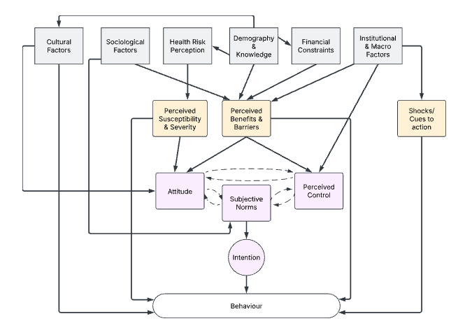
Background & Gaps II

Slide 21
Data
MIT C19 preventative health survey
Conducted via online surveys distributed to Facebook users globally
Over 100k observations across 78 countries
Weighted to account for probability of being FB user
Contains data on all aforementioned factors
Repeated cross sectional survey
Requesred & granted. Currently correspondence between LSE Datalibrary and MIT.

Slide 22
Methods I
Approach
Structural equation modelling to uncover latent and observed pathways
Explicitly models causal pathways and feedback loops
Estimated using system modelling like maximum likelihood, Generalized least squares, Bayesian estimation
Examples of application are
Newton et al. (2024) modelling Health outcomes as a function of social determinagts of health in UK.
Li et al. (2020) modelling dementia care ability as a function of health literacy and social support in China
Notes:
GLM: small sample but requires normal distributions GLS: needs large sample but more flexible to distributoions Bayes: requires priors

Slide 23
Methods II
Approach
Structural equation modelling to uncover latent and observed pathways
Allows simultaneous estimation of direct and indirect effects in predicting preventive behavior
Direct, indirect, and total effects analysed for all models
Conduct at different waves for robustness checks and comparison
Evaluation of goodness of fit between HBM, TPB, extended and integrated version using AIC/BIC
Evaluation of overfitting via multi-round application of estimated parameters and assesment of goodnes of fit variation

Slide 24
Expected Contributions
Emprical contribution
First large scale SEM across countries and waves
Qunatification of uncertainity and relative importance of factors
Theoretical Contribution
Informing more comprehensive framework of pandemic behaviour
Introducing nuance around different intervention types (NPIs vs vaccine)
Policy relevance
Informs more efficient data collections during early phases of emergencies
Informs ressource allocation efficiency

Slide 25
Chapter II: Qunatifying the health-income trade-off assumption
RQ: What is the relative importance of economic constraints and health risk perceptions on compliance with public health measures?

Slide 26
Background & Gaps
Widely assumed trade-off between income an health that individuals face
Rationale behind cash transfer programmes
Supported by economic theory (Grossman 1972); Prospect Theory
Empirical eveidence shows
Effects of income (e.g. Stevens et al. 2021)
Effects of risk perceptions (e.g. Bazrafshan et al. 2023)
Income and risk perception never modelled together to confirm trade-off in causal way

Slide 27
Hypotheses
H1(2): Economic vulnerability (health risk perceptions) predict compliance.
H3: Individuals face a trade-off between preserving their health and their economic security.

Slide 28
Data
World Bank Malawi high frequency phone survey between 2020 and 2024
Subset: 05/20-07/21
Only the first 13 rounds contain information about non-pharmaceutical mitigation behaviour
Nationally representative sample of households based on the Malawi National Integrated Household Panel Survey from 2019
1729 participants at baseline & 8% attrition at R13
Further weighting based on census data

Slide 29
Methods: Double Debiased Machine Learning I
Traditional econometric approaches
Identification of pure effect requires isolation from confounding
Including limited confounding information -> endogeneity concerns
Including a lot of controls -> modelling challenges due to complex functional forms (eg colinearity, non-linearity, etc.) (Belloni et al. 2017)
Machine Learning
Can handle complex functional forms and data patterns (eg many non-linear controls, colinearity) for predicting outcomes.
Delineating different factor’s distinct influence challenging.
Estimates difficult to interpret due to (often) non-tracable data trahsformations.

Slide 30
Methods: Double Debiased Machine Learning II
Combining the benefits of both approaches
Proposed by Chernozhukov et al. (2018)
Predict behaviour & treatment separately given vector of covariates using ML methods
Regress residuals of predicted outcome (i.e. the variation in outcome unexplained by covariates) on residuals of predicted treatment (ie the variation in treatment not explained by covariates)
Estimate = Causal effect of treatment on outcome
Based orthogonalization proposed by Neyman and Scott (1948)

Slide 31
Expected Contributions
Emprical contribution
First causal investigation into health/income trade-off in context of protective measures during a pandemic
Qunatification of trade-off and comparison over time
Theoretical Contribution
Empirical test of widely-assumed trade-off assumption
Policy relevance
Informs more efficient data collections during early phases of emergencies
Informs ressource allocation efficiency

Slide 32
Chapter: The role of peer effects on vaccination intentions
RQ: What is the effect of membership in non self-selected peer groups on vaccination intentions?

Slide 33
Background & Gaps

Slide 34
Methods

Slide 35
Data

Slide 36
Expected Contributions

Slide 37
Emprical contribution

Slide 38
Theoretical Contribution

Slide 39
Policy relevance

Slide 40
Thank you!

Slide 41
Questions & Feedback

Slide 42
Annex: Literature search strategy II: Search string
TITLE-ABS-KEY( (pandemic* OR epidemic* OR outbreak* OR "public health crisis*") AND (behavio*r OR compliance OR adherence OR "preventiv* measures" OR "protective measures" OR mitigation OR "health response*" OR lockdown* OR "stay at home" OR "social distan*" OR quarantine OR "mask* use" OR "mask wearing" OR hygiene OR "hand wash*" OR "vaccine acceptance" OR "vaccination intent*" OR "testing uptake" OR "contact tracing" OR "physical distancing" OR "non-pharmaceutical intervention*") ) AND TITLE-ABS-KEY( (determinant* OR predictor* OR factor* OR driver* OR influenc*) AND (economic OR "socio-cultural" OR social OR institutional OR psychological OR "risk perception*" OR cognitive OR affective OR normative OR "peer effect*" OR "media influence*" OR politic* OR demographic* OR cultural OR structural OR contextual) )

Slide 43
Annex I: Chapter I

Slide 44
Annex: Structural Equation Modelling II (Skip)
Confirmatory Factor Analysis (CFA)
To validate latent constructs
To operationalise constructs from survey items
Comparative Model Evaluation
Predictive power assessment (variance explained in preventative behavior)
Multi-group SEM for cross-country/SES/gender comparisons
Akaike Information Criterion (AIC) & Bayesian Information Criterion (BIC) for model comparison

Slide 45
Annex II Chapter 2

Slide 46
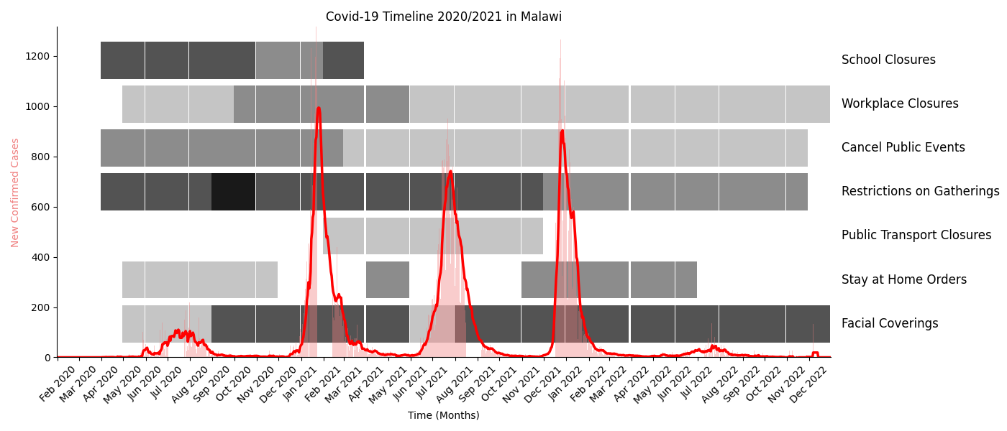
Annex: Chapter II BG: Malawi during waves 1 & 2 of C19

Slide 47
Outcome | Indicators | Investigation at | Hypothesis tests
Social distancing | Gathering attendance; non-essential travels; Reduced Shopping | Multiple rounds | H1, H2, H3
Hygiene & Mask | Hand Washing; Mask Wearing | Single Round | H2
Willingness to test* | Willingness to test | Single Round | H1
Vaccine Acceptance* | Willingness to vaccinate | Single round | H1
Annex: Chapter II How: Outcomes

Slide 48
*Vaccines and tests are provided for free but involve significant transaction and opportunity costs. Reddy, K.P., Fitzmaurice, K.P., Scott, J.A. et al. Clinical outcomes and cost-effectiveness of COVID-19 vaccination in South Africa. Nat Commun 12, 6238 (2021)

Slide 49
Annex: Chapter II How: Treatments I
Economic Vulnerability Indicator
Constructed from factors such as:
Current income
Self-reported economic stability perception
Economic risk perception due to the pandemic
Main income source (formal vs. informal economy)
Consumption quantile (based on monthly spending)
Operationalization methods under consideration:
Inverse Probability Weighting (IPW) by Anderson
Established economic vulnerability measures (e.g., Calvo & Dercon, 2005)
Data-driven approach (PCA or single factor analysis)

Slide 50
Annex: Chapter II How: Treatments II
Health Risk Perception Indicator
Self-reported health risk perception
Infection history and self-reported comorbidities
Recent Covid-19 symptoms
Trade-off as interaction term

Slide 51
Annex: Chapter II How: Controlling for …
Demographics (Age, gender, education, urban/rural, etc.)
Cultural affiliations and beliefs (religion, parties, norms, etc.)
HH characteristics (size, adult equiv., etc.)
Exposure to C19
Trust in institutions & conspiracy beliefs
Mental health
Macro context (policies, economic performance, etc.)
And some more (self-efficacy, C19 communication exposure, news consumption, etc.)

Slide 52
Annex: Chapter II How: Challenges of traditional econometric approaches I

Slide 53
Annex: Chapter II How: Challenges of traditional econometric approaches II
Strengths
Interpretability
Causal pathway identification
Limitations
Exogeneity concerns
Either RCT or
Quasiexperimental approach difficult with income
Controlling requires many functional assumptions

Slide 54
Annex: Chapter II How: Challenges of machine learning
Strengths
Very flexible re functional forms
Can handle large amounts of covariates
Limitations
Overfitting concerns
Causal pathway interpretation challenging

Slide 55
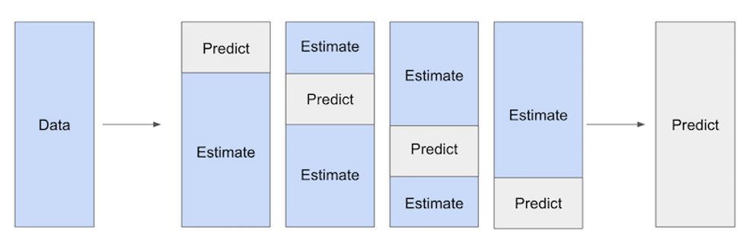
Annex: Chapter II How: Double Debiased Machine Learning II
Cross-fitting to reduce overfitting and regularization bias

Slide 56
Annex III Chapter 3

Slide 57
Alvarez-Galvez, J, A Anastasiou, D Lamnisos, M Constantinou, C Nicolaou, S Papacostas, VS Vasiliou, et al. 2023. “The Impact of Government Actions and Risk Perception on the Promotion of Self-Protective Behaviors During the COVID-19 Pandemic.” PLOS ONE 18 (4). https://doi.org/10.1371/journal.pone.0284433.
Badr, Hoda, Xiaotao Zhang, Abiodun Oluyomi, LeChauncy D. Woodard, Omolola E. Adepoju, Syed Ahsan Raza, and Christopher I. Amos. 2021. “Overcoming COVID-19 Vaccine Hesitancy: Insights from an Online Population-Based Survey in the United States.” Vaccines 9 (10): 1100. https://doi.org/10.3390/vaccines9101100.
Bazrafshan, A, A Sadeghi, MS Bazrafshan, H Mirzaie, M Shafiee, J Geerts, and H Sharifi. 2023. “Health Risk Communication and Infodemic Management in Iran: Development and Validation of a Conceptual Framework.” BMJ OPEN 13 (7). https://doi.org/10.1136/bmjopen-2023-072326.
Belloni, A., V. Chernozhukov, I. Fern�ndez-Val, and C. Hansen. 2017. “Program Evaluation and Causal Inference With High-Dimensional Data.” Econometrica 85 (1): 233–98. https://doi.org/10.3982/ECTA12723.
Bui, Huy Nhuong, Cong Doanh Duong, Van Quang Nguyen, Ngoc Xuan Vu, Son Tung Ha, Trung Thanh Le, and Trong Nghia Vu. 2023. “Utilizing the Theory of Planned Behavior to Predict COVID-19 Vaccination Intention: A Structural Equational Modeling Approach.” Heliyon 9 (6): e17418. https://doi.org/10.1016/j.heliyon.2023.e17418.
Catma, Serkan, and Serkan Varol. 2021. “Willingness to Pay for a Hypothetical COVID-19 Vaccine in the United States: A Contingent Valuation Approach.” Vaccines 9 (4): 318. https://doi.org/10.3390/vaccines9040318.
Chernozhukov, Victor, Denis Chetverikov, Mert Demirer, Esther Duflo, Christian Hansen, Whitney Newey, and James Robins. 2018. “Double/Debiased Machine Learning for Treatment and Structural Parameters.” The Econometrics Journal 21 (1): C1–68. https://doi.org/10.1111/ectj.12097.
Erman, Aysegul, and Mike Medeiros. 2021. “Exploring the Effect of Collective Cultural Attributes on Covid-19-Related Public Health Outcomes.” Frontiers in Psychology 12 (March): 627669. https://doi.org/10.3389/fpsyg.2021.627669.
Ferreira Caceres, Maria Mercedes, Juan Pablo Sosa, Jannel A Lawrence, Cristina Sestacovschi, Atiyah Tidd-Johnson, Muhammad Haseeb UI Rasool, Vinay Kumar Gadamidi, et al. 2022. “The Impact of Misinformation on the COVID-19 Pandemic.” AIMS Public Health 9 (2): 262–77. https://doi.org/10.3934/publichealth.2022018.
Filsinger, M, and M Freitag. 2024. “Asymmetric Affective Polarization Regarding COVID-19 Vaccination in Six European Countries.” SCIENTIFIC REPORTS 14 (1). https://doi.org/10.1038/s41598-024-66756-w.
Gelfand, Michele J, Joshua Conrad Jackson, Xinyue Pan, Dana Nau, Dylan Pieper, Emmy Denison, Munqith Dagher, Paul A M Van Lange, Chi-Yue Chiu, and Mo Wang. 2021. “The Relationship Between Cultural Tightness–Looseness and COVID-19 Cases and Deaths: A Global Analysis.” The Lancet. Planetary Health 5 (3): e135–44. https://doi.org/10.1016/S2542-5196(20)30301-6.
Govind, R, N Garg, and L Carter. 2024. “Selling Hope Versus Hate: The Impact of Partisan Social Media Messaging on Social Distancing During the COVID-19 Pandemic.” EUROPEAN JOURNAL OF MARKETING 58 (2): 632–58. https://doi.org/10.1108/EJM-12-2022-0911.
Grossman, Michael. 1972. “On the Concept of Health Capital and the Demand for Health.” Journal of Political Economy 80 (2): 223–55. https://www.jstor.org/stable/1830580.
Guimaraes, RM, JHCM da Silva, GPD Brusse, and TCD Martins. 2021. “Effect of Physical Distancing on Covid-19 Incidence in Brazil: Does the Strictness of Mandatory Rules Matter?” HEALTH POLICY AND PLANNING 36 (10): 1605–12. https://doi.org/10.1093/heapol/czab110.
He, YP, H Yatsuya, A Ota, and T Tabuchi. 2022. “The Association of Public Trust with the Utilization of Digital Contact Tracing for COVID-19 in Japan.” PUBLIC HEALTH IN PRACTICE 4 (December). https://doi.org/10.1016/j.puhip.2022.100279.
Keshet, Y. 2020. “Fear of Panoptic Surveillance: Using Digital Technology to Control the COVID-19 Epidemic.” ISRAEL JOURNAL OF HEALTH POLICY RESEARCH 9 (1). https://doi.org/10.1186/s13584-020-00429-7.
Li, Yongnan, Lanying Hu, Xin’e Mao, Yijing Shen, Huiping Xue, Ping Hou, and Yongbing Liu. 2020. “Health Literacy, Social Support, and Care Ability for Caregivers of Dementia Patients: Structural Equation Modeling.” Geriatric Nursing 41 (5): 600–607. https://doi.org/10.1016/j.gerinurse.2020.03.014.
Makridis, Christos A., and Cary Wu. 2021. “How Social Capital Helps Communities Weather the COVID-19 Pandemic.” PLOS ONE 16 (1): e0245135. https://doi.org/10.1371/journal.pone.0245135.
Miftode, RS, II Costache, P Cianga, AO Petris, CM Cianga, MA Maranduca, IL Miftode, et al. 2021. “The Influence of Socioeconomic Status on the Prognosis and Profile of Patients Admitted for Acute Heart Failure During COVID-19 Pandemic: Overestimated Aspects or a Multifaceted Hydra of Cardiovascular Risk Factors?” HEALTHCARE 9 (12). https://doi.org/10.3390/healthcare9121700.
Miyazato, Naomi, Yoko Ibuka, and Jun-ichi Itaya. 2024. “Peer Effects on Influenza Vaccination: Evidence from a City’s Administrative Data in Japan.” Journal of the Japanese and International Economies 74 (December): 101335. https://doi.org/10.1016/j.jjie.2024.101335.
Mohammed, E, S Khanal, Z Jalal, E Cheema, MH Abutaleb, and V Paudyal. 2021. “Perceived Barriers and Facilitators to Uptake of Non-Traditional Roles by Pharmacists in Saudi Arabia and Implications for COVID-19 Pandemic and Beyond: A Qualitative Study Using Theoretical Domain Framework.” JOURNAL OF PHARMACEUTICAL POLICY AND PRACTICE 14 (1). https://doi.org/10.1186/s40545-021-00307-w.
Nair, Nisha, Patturaja Selvaraj, and Ranjeet Nambudiri. 2022. “Culture and COVID-19: Impact of Cross-Cultural Dimensions on Behavioral Responses.” Encyclopedia 2 (3): 1210–24. https://doi.org/10.3390/encyclopedia2030081.
Neville, Fergus G., Anne Templeton, Joanne R. Smith, and Winnifred R. Louis. 2021. “Social Norms, Social Identities and the COVID-19 Pandemic: Theory and Recommendations.” Social and Personality Psychology Compass 15 (5): e12596. https://doi.org/10.1111/spc3.12596.
Newton, D., J. Stephenson, L. Azevedo, R. K. Sah, A. N. Poudel, and O. Richardson. 2024. “The Impact of Social Determinants on Health Outcomes in a Region in the North of England: A Structural Equation Modelling Analysis.” Public Health 231 (June): 198–203. https://doi.org/10.1016/j.puhe.2024.03.024.
Neyman, J., and Elizabeth L. Scott. 1948. “Consistent Estimates Based on Partially Consistent Observations.” Econometrica 16 (1): 1–32. https://doi.org/10.2307/1914288.
Stevens, AJ, AM Ray, A Thirunavukarasu, E Johnson, L Jones, A Miller, and JWT Elston. 2021. “The Experiences of Socially Vulnerable Groups in England During the COVID-19 Pandemic: A Rapid Health Needs Assessment.” PUBLIC HEALTH IN PRACTICE 2 (November). https://doi.org/10.1016/j.puhip.2021.100192.
Wollast, Robin, Mathias Schmitz, Alix Bigot, and Olivier Luminet. 2021. “The Theory of Planned Behavior During the COVID-19 Pandemic: A Comparison of Health Behaviors Between Belgian and French Residents.” PLoS ONE 16 (11): e0258320. https://doi.org/10.1371/journal.pone.0258320.
Xiong, YF, CT Wang, and Y Zhang. 2024. “Interacting Particle Models on the Impact of Spatially Heterogeneous Human Behavioral Factors on Dynamics of Infectious Diseases.” PLOS COMPUTATIONAL BIOLOGY 20 (8). https://doi.org/10.1371/journal.pcbi.1012345.
Zu, J, MW Shen, CK Fairley, ML Li, GQ Li, LB Rong, YN Xiao, GH Zhuang, L Zhang, and Y Li. 2021. “Investigating the Relationship Between Reopening the Economy and Implementing Control Measures During the COVID-19 Pandemic.” PUBLIC HEALTH 200 (November): 15–21. https://doi.org/10.1016/j.puhe.2021.09.005.
Zucoloto, ML, AC Meneghini, and EZ Martinez. 2022. “Panorama of COVID-19, Risk Perception and Vaccine Confidence in Sao Paulo State Population, Southeast Brazil.” HEALTH & SOCIAL CARE IN THE COMMUNITY 30 (6): E4662–72. https://doi.org/10.1111/hsc.13872.

